Slide 1
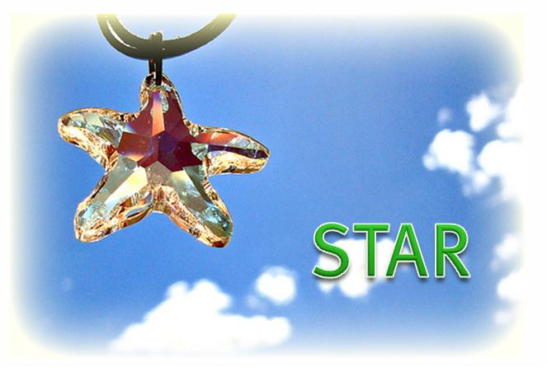
STAR Project Mid-term Review
Deep Learning Frameworks atop of Spark

Slide 2
Team Introduction
Sponsor
Sun, Ricky
Coordinator
Xu, Xinlei
Adviser
Dong, Zhe
Li, Mao
Du, Duke
Wang,Jiayin
Zhou,
Qiaosheng

Slide 3
Project Overview
Project background
Deep learning is a raging fire in recent years.
Most of these are single-machine and leverage GPU’s computing capability.
In recent years mature distributed computing frameworks like Spark are applied in deep learning.
Project target
Get understanding of deep learning
Familiar with distributed deep learning framework.
Choose some the most popular deep learning framework and do performance evaluation.

Slide 4
Key features
SparkNet
A framework for training deep networks in Spark.
convenient interface for reading data from Spark RDDs.
A Scala interface to the Caffe deep learning framework
A lightweight multi-dimensional tensor library
DeepLearning4J
distributed neural net library written in Java and Scala.
integrates with Hadoop and Spark.
CaffeOnSpark
a distributed extension of Caffe
Supports neural network model training, testing, and feature extraction.

Slide 5
Current progress
Warmup:
Learning some background knowledge of Deep Learning
Setup:
Setup “SparkNet”, “DeepLearning4J”, “CaffeOnSpark” deep learning framework environment
Modeling:
Prepare performance evaluation test data and test cases
Evaluation:
Run test cases and get performance data
Final Report:
Finale performance cooperation reports

Slide 6
Project Timeline
Current
March
April
May
July
Aug
Warmup
Setup
Modeling
Evaluate
Report
Project is on track basically but have some risks:
Environment is still not stable
Team members are busy on their own BU projects

Slide 7
Q&A

